Slide 1



Custom Access Denied Page
m

Slide 2
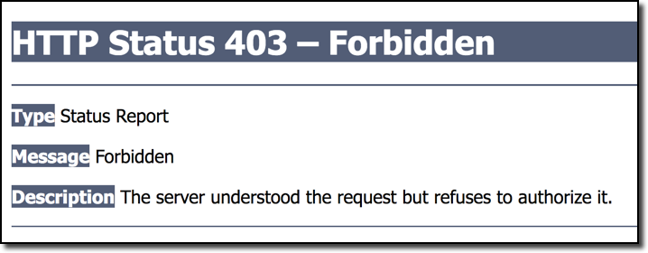
Default Access Denied Page
www.luv2code.com

Slide 3



Custom Access Denied Page
You can customize this page
HTML + CSS
www.luv2code.com

Slide 4
Development Process
Step-By-Step
Configure custom page for access denied
Create supporting controller code and view page
www.luv2code.com

Slide 5



Step 1: Configure custom page access denied
@Override
protected void configure(HttpSecurity http) throws Exception {
…
.exceptionHandling()
.accessDeniedPage(“/access-denied”);
}
Our request mapping path
www.luv2code.com

Slide 6
Step 2: Create Supporting Controller code and View Page
www.luv2code.com

Slide 7
Display Content Based on Roles
m

Slide 8

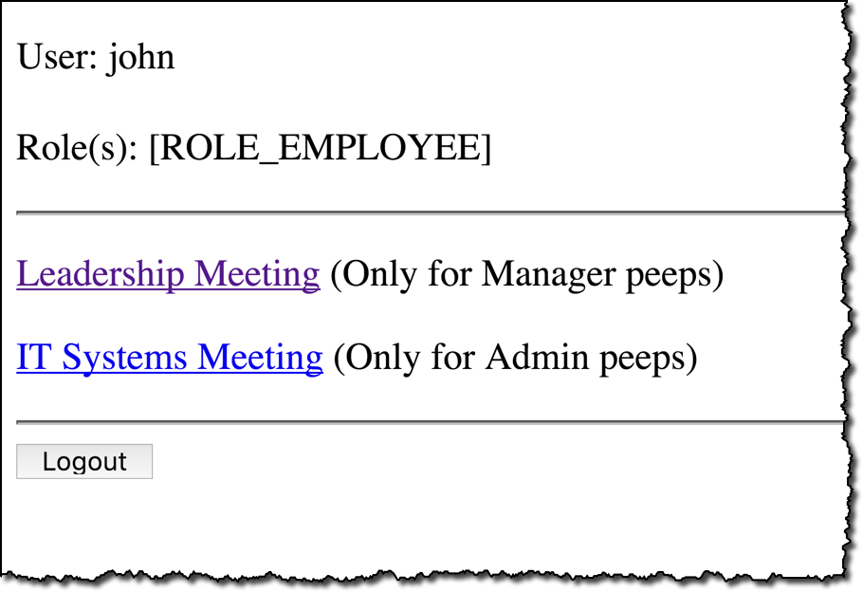
Why Show These Links?
Since John is an employee,
he shouldn’t be able to see this content / links
www.luv2code.com

Slide 9


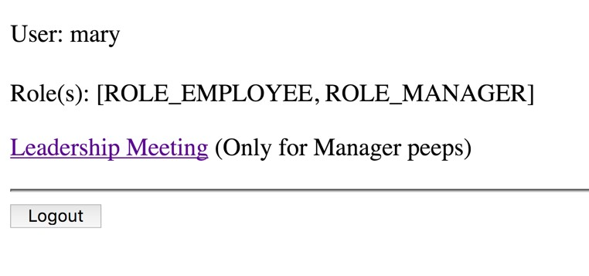


Display Content Based on Roles
Logged in as Mary
Mary can see MANAGER content
www.luv2code.com

Slide 10





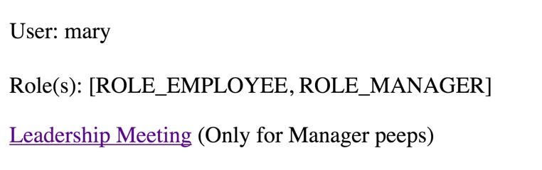
Spring Security JSP Tags
Only show this section for users with MANAGER role
…
<security:authorize access="hasRole('MANAGER')">
<p>
<a href=“${pageContext.request.contextPath}/leaders"> Leadership Meeting
</a>
(Only for Manager peeps)
</p>
</security:authorize>
www.luv2code.com

Slide 11


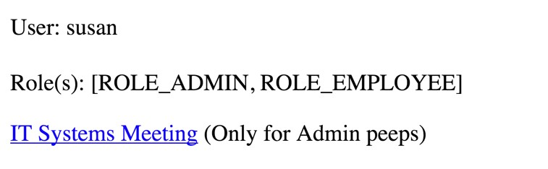

Display Content Based on Roles
Logged in as Susan
Susan can see ADMIN content
www.luv2code.com

Slide 12





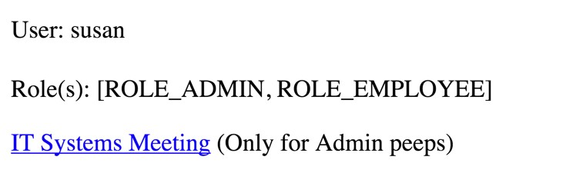
Spring Security JSP Tags
Only show this section for users with ADMIN role
…
<security:authorize access="hasRole('ADMIN')">
<p>
<a href=“${pageContext.request.contextPath}/systems”> IT Systems Meeting
</a>
(Only for Admin peeps)
</p>
</security:authorize>
www.luv2code.com

